Slide 1
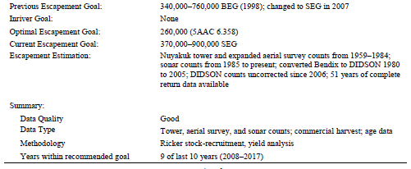
 |  | Total
Year | Escapement | return
1959 | 67,553 | 251,110
1960 | 201,161 | 554,162
1961 | 110,369 | 466,173
1962 | 51,273 | 152,649
1963 | 234,821 | 214,841
1964 | 134,853 | 93,342
1965 | 255,794 | 779,754
1966 | 233,578 | 701,566
1967 | 74,003 | 227,033
1968 | 142,360 | 344,179
1969 | 95,805 | 493,692
1970 | 452,892 | 988,764
1971 | 312,699 | 1,010,999
1972 | 39,851 | 1,147,980
1973 | 210,601 | 1,380,189
1974 | 204,190 | 383,623
1975 | 832,093 | 5,995,149
1976 | 520,303 | 4,351,924
1977 | 611,588 | 3,236,089
1978 | 734,040 | 1,513,725
1979 | 551,272 | 1,846,153
1980 | 3,669,136 | 1,210,266
1981 | 1,118,873 | 1,976,757
1982 | 664,580 | 1,335,148
1983 | 446,845 | 1,548,738
1984 | 655,739 | 761,247
1985 | 551,319 | 1,416,870
1986 | 1,095,241 | 2,092,574
1987 | 429,182 | 1,905,456
1988 | 534,460 | 2,557,339
1989 | 567,863 | 1,398,722
1990 | 752,513 | 1,189,247
.
.
.
2009 | 563,334 | 425,915
Nushagak River Sockeye
Data: S and R, 1959-2009
Method: SRA (Follow lab instructions)
Issue: No easy way to get harvest rates
More Info: Erickson et al FMS 18-06
N = 51 brood years

Slide 2
 |  | Return
Year | Escapement | age.3 | age.4 | age.5 | age.6
1978 | 1,535,690 | 23,791 | 1,410,720 | 997,108 | 11,827
1979 | 1,136,990 | 82,894 | 1,319,590 | 711,604 | 23,428
1980 | 1,812,320 | 56,870 | 2,475,740 | 1,348,410 | 16,695
1981 | 2,657,730 | 82,359 | 2,833,010 | 2,603,730 | 69,404
1982 | 1,368,380 | 83,426 | 1,540,540 | 661,772 | 14,933
1983 | 1,246,140 | 12,945 | 1,092,060 | 1,320,780 | 18,983
1984 | 2,294,960 | 38,802 | 2,824,220 | 2,163,830 | 22,705
1985 | 3,257,830 | 30,502 | 1,402,040 | 893,277 | 12,285
1986 | 2,889,930 | 37,336 | 884,616 | 1,285,640 | 80,397
1987 | 1,027,450 | 23,585 | 1,147,660 | 1,626,920 | 47,806
1988 | 2,556,340 | 31,610 | 823,334 | 668,707 | 20,703
1989 | 2,174,760 | 19,397 | 991,100 | 2,080,370 | 87,344
1990 | 1,278,090 | 33,743 | 1,327,390 | 1,926,840 | 71,927
1991 | 1,837,260 | 48,469 | 2,259,220 | 1,960,660 | 36,402
1992 | 1,964,950 | 90,032 | 2,179,890 | 1,062,100 | 20,930
1993 | 1,513,060 | 43,513 | 561,968 | 260,312 | 8,964
1994 | 3,167,320 | 10,257 | 723,350 | 694,285 | 9,444
1995 | 3,646,620 | 16,211 | 445,324 | 239,053 | 4,594
1996 | 3,656,790 | 10,195 | 311,251 | 425,834 | 19,317
1997 | 1,389,210 | 1,853 | 119,187 | 444,707 | 26,942
1998 | 906,001 | 2,667 | 813,293 | 325,409 | 426
1999 | 1,059,030 | 17,812 | 899,584 | 615,662 | 8,291
2000 | 490,083 | 16,091 | 758,033 | 221,234 | 1,350
2001 | 494,043 | 92,552 | 2,461,590 | 2,942,250 | 133,202
2002 | 1,209,290 | 67,433 | 1,040,400 | 885,875 | 48,423
2003 | 1,189,040 | 37,218 | 1,126,580 | 1,108,010 | 35,982
2004 | 1,370,590 | 20,281 | 889,988 | 608,397 | 9,410
2005 | 2,638,440 | 36,446 | 1,025,360 | 277,701 | 2,606
2006 | 3,838,210 | 57,604 | 1,242,620 | 1,204,610 | 54,058
2007 | 1,890,930 | 133,712 | 1,148,650 | 679,462 | 44,663
2008 | 1,863,290 | 65,180 | 1,728,480 | 1,958,250 | 84,081
2009 | 1,489,330 | 22,323 | 1,342,120 | 1,416,490 | 24,889
2010 | 1,364,600 | 29,118 | 989,220 | 1,181,900 | 41,805
2011 | 2,068,170 | 19,539 | 765,527 | 988,419 | 32,817
2012 | 2,061,000 | 39,142 | 1,562,990 | 1,612,540 | NA
2013 | 2,796,590 | 25,860 | 1,980,710 | NA | NA
2014 | 1,911,090 | 11,876 | NA | NA | NA
2015 | 1,586,040 | NA | NA | NA | NA
2016 | 1,907,500 | NA | NA | NA | NA
2017 | 3,009,760 | NA | NA | NA | NA
Yukon River Summer Chum
1978-2017
Data: Brood table by age
Method: Complete table, conduct SRA as before
Undo brood table to get harvest rates
Issue: Note that S and R were not directly estimated;
they were reconstructed from historical data using
multiple information sources. Some escapements
have measurement error CVs of 0.30
More Info: Hamachan and Conitz FMS 15-07

Slide 3
Brood |  | Adult Return
Year | Escapement | 0.2 | 1.1 | 0.3 | 1.2 | 2.1 | 0.4 | 1.3 | 2.2 | 3.1 | 1.4 | 2.3 | 3.2 | 2.4 | 3.3
1968 | 90,958 | NA | NA | NA | NA | NA | NA | NA | NA | NA | NA | NA | NA | NA | NA
1969 | 46,964 | NA | NA | NA | NA | NA | NA | NA | NA | NA | NA | NA | NA | NA | NA
1970 | 38,797 | NA | NA | NA | NA | NA | NA | NA | NA | NA | NA | NA | NA | NA | NA
1971 | 91,887 | 0 | 0 | NA | NA | NA | NA | NA | NA | NA | NA | NA | NA | NA | NA
1972 | 115,486 | 0 | 231 | 0 | 86,418 | 115 | NA | NA | NA | NA | NA | NA | NA | NA | NA
1973 | 40,880 | 0 | 0 | 0 | 12,833 | 204 | 0 | 42,653 | 14,079 | 0 | NA | NA | NA | NA | NA
1974 | 71,540 | 0 | 0 | 0 | 38,507 | 299 | 0 | 85,255 | 6,389 | 0 | 0 | 2,588 | 0 | NA | NA
1975 | 48,884 | 49 | 494 | 0 | 36,811 | 268 | 0 | 8,744 | 69,392 | 0 | 0 | 5,484 | 0 | 0 | 0
1976 | 142,058 | 0 | 473 | 0 | 115,995 | 0 | 0 | 107,438 | 101,308 | 0 | 0 | 51,297 | 0 | 522 | 0
1977 | 158,410 | 0 | 2,753 | 0 | 119,001 | 2,433 | 0 | 103,393 | 114,377 | 0 | 0 | 49,258 | 0 | 0 | 0
1978 | 119,165 | 0 | 0 | 0 | 206,299 | 0 | 0 | 176,558 | 38,748 | 0 | 0 | 38,332 | 0 | 0 | 0
1979 | 155,527 | 440 | 1,801 | 0 | 180,735 | 0 | 0 | 80,966 | 34,636 | 0 | 0 | 4,521 | 0 | 0 | 0
1980 | 188,314 | 0 | 4,087 | 0 | 246,019 | 0 | 0 | 111,456 | 20,631 | 0 | 1,350 | 16,890 | 0 | 0 | 0
1981 | 262,271 | 0 | 0 | 0 | 149,225 | 0 | 0 | 368,132 | 33,934 | 0 | 0 | 8,677 | 0 | 0 | 0
1982 | 184,204 | 0 | 2,465 | 0 | 172,123 | 465 | 0 | 358,492 | 51,558 | 0 | 0 | 41,369 | 0 | 0 | 0
1983 | 215,730 | 0 | 0 | 0 | 407,690 | 0 | 0 | 364,997 | 104,687 | 0 | 0 | 46,809 | 0 | 0 | 0
1984 | 238,413 | 0 | 0 | 0 | 264,207 | 577 | 0 | 204,991 | 112,060 | 0 | 0 | 53,408 | 0 | 0 | 0
1985 | 512,827 | 0 | 2,187 | 0 | 854,061 | 1,742 | 0 | 485,118 | 258,171 | 0 | 2,937 | 52,479 | 0 | 0 | 0
1986 | 283,054 | 748 | 0 | 0 | 529,984 | 267 | 0 | 679,270 | 220,031 | 0 | 3,504 | 71,144 | 0 | 1,199 | 0
1987 | 256,707 | 0 | 709 | 0 | 348,596 | 484 | 0 | 345,805 | 266,602 | 0 | 0 | 95,613 | 236 | 0 | 0
1988 | 204,336 | 0 | 143 | 0 | 255,882 | 382 | 0 | 353,642 | 239,227 | 0 | 1,718 | 141,028 | 0 | 2,489 | 0
1989 | 164,952 | 0 | 0 | 0 | 62,021 | 129 | 0 | 163,788 | 252,891 | 0 | 244 | 65,366 | 0 | 0 | 0
1990 | 147,663 | 0 | 656 | 596 | 101,750 | 0 | 0 | 133,572 | 123,311 | 0 | 1,476 | 90,632 | 934 | 0 | 0
1991 | 233,646 | 214 | 0 | 775 | 133,031 | 162 | 0 | 232,645 | 189,244 | 0 | 769 | 49,795 | 0 | 0 | 0
1992 | 188,819 | 0 | 0 | 0 | 159,892 | 738 | 0 | 330,225 | 248,546 | 0 | 0 | 150,016 | 0 | 0 | 0
1993 | 151,801 | 0 | 567 | 0 | 63,863 | 590 | 0 | 197,694 | 173,302 | 0 | 0 | 174,387 | 0 | 0 | 0
1994 | 218,826 | 0 | 0 | 0 | 147,703 | 0 | 0 | 189,085 | 145,680 | 0 | 0 | 133,336 | 0 | 0 | 0
1995 | 202,428 | 0 | 386 | 0 | 222,798 | 0 | 0 | 110,369 | 174,950 | 0 | 0 | 113,166 | 0 | 0 | 0
1996 | 264,511 | 0 | 0 | 0 | 185,940 | 0 | 0 | 414,977 | 205,588 | 0 | 0 | 68,223 | 0 | 0 | 0
1997 | 263,780 | 0 | 0 | 0 | 145,659 | 0 | 0 | 453,802 | 122,402 | 0 | 0 | 102,874 | 0 | 0 | 0
1998 | 259,045 | 682 | 388 | 0 | 195,201 | 1,883 | 0 | 155,518 | 125,775 | 0 | 1,496 | 51,892 | 0 | 0 | 0
1999 | 312,481 | 0 | 0 | 0 | 237,182 | 373 | 0 | 297,531 | 196,873 | 0 | 1,801 | 92,168 | 441 | 0 | 0
2000 | 263,631 | 0 | 403 | 0 | 208,276 | 1,202 | 0 | 190,926 | 56,162 | 0 | 0 | 74,041 | 0 | 0 | 0
2001 | 318,735 | 0 | 1,386 | 0 | 217,593 | 707 | 0 | 377,605 | 109,373 | 0 | 1,141 | 42,235 | 1,019 | 0 | 0
2002 | 235,732 | 0 | 1,542 | 0 | 206,816 | 4,941 | 0 | 279,338 | 118,996 | 0 | 1,958 | 53,153 | 0 | 491 | 0
2003 | 353,526 | 0 | 2,972 | 0 | 279,767 | 1,343 | 0 | 264,189 | 248,417 | 0 | 0 | 65,542 | 0 | 0 | 0
2004 | 523,653 | 966 | 1,287 | 0 | 614,279 | 1,272 | 0 | 224,666 | 511,584 | 0 | 1,194 | 65,365 | 0 | 0 | 0
2005 | 360,065 | 0 | 4,747 | 0 | 420,057 | 1,918 | 0 | 468,763 | 191,547 | 0 | 0 | 139,448 | 538 | 0 | 0
2006 | 389,645 | 0 | 10,152 | 0 | 663,235 | 7,708 | 0 | 573,939 | 515,285 | 0 | 0 | 109,599 | 0 | 0 | 0
2007 | 365,184 | 0 | 7,406 | 0 | 517,851 | 1,852 | 0 | 292,890 | 222,994 | 0 | 0 | 114,216 | 0 | 0 | 0
2008 | 327,018 | 0 | 5,672 | 0 | 622,458 | 2,836 | 0 | 603,710 | 282,320 | 0 | 0 | 58,449 | 0 | 0 | 0
2009 | 326,283 | 0 | 8,066 | 0 | 128,287 | 24,088 | 0 | 501,436 | 298,674 | 0 | 1,989 | 142,431 | 0 | 0 | 0
2010 | 295,265 | 1,719 | 8,596 | 0 | 226,513 | 12,034 | 0 | 255,738 | 255,738 | 0 | 0 | 58,286 | 0 | 0 | 0
2011 | 245,721 | 0 | 11,741 | 0 | 110,448 | 21,782 | 0 | 249,075 | 207,535 | 0 | 0 | 209,155 | 0 | 0 | 0
2012 | 374,523 | 0 | 42,815 | 0 | 215,278 | 28,080 | 0 | 66,847 | 237,982 | 0 | 0 | 41,424 | 0 | 0 | 0
2013 | 489,654 | 1,906 | 19,460 | 0 | 346,060 | 11,636 | 0 | 268,221 | 318,776 | 0 | 0 | 37,013 | 0 | 0 | 0
2014 | 440,192 | 4,191 | 18,970 | 0 | 467,313 | 29,448 | 0 | 324,152 | 227,315 | 0 | 0 | 31,544 | 0 | 0 | 0
2015 | 470,677 | 2,232 | 5,522 | 0 | 246,611 | 12,219 | 0 | 409,452 | 415,209 | 0 | 0 | 83,653 | 0 | 0 | 0
2016 | 239,981 | 0 | 7,664 | 0 | 143,497 | 9,406 | 0 | 97,688 | 188,641 | 0 | 720 | 32,518 | 639 | 0 | 0
2017 | 358,724 | 0 | 22,034 | 0 | 284,613 | 32,073 | 0 | 152,743 | 191,458 | 0 | 954 | 117,098 | 0 | 929 | 0
2018 | 388,009 | 0 | 4,649 | 0 | 368,806 | 9,001 | 0 | 73,061 | 242,906 | 0 | 0 | 4,579 | 0 | 0 | 0
Kasilof River Sockeye
1968-2018
Data: Annual run by age, escapement, harvest
Method: Construct brood table
More Info: Erickson et al FMS 17-03

Slide 4
 | Escapement
Year | Jacks | Adults | Harvest
1980 | 227 | 566 | 70
1981 | 189 | 592 | 300
1982 | 335 | 417 | 290
1983 | 224 | 630 | 473
1984 | 304 | 614 | 487
1985 | 119 | 937 | 710
1986 | 288 | 428 | 498
1987 | 206 | 660 | 531
1988 | 425 | 736 | 433
1989 | 311 | 504 | 616
1990 | 165 | 678 | 750
1991 | 314 | 812 | 183
1992 | 271 | 1,020 | 295
1993 | 876 | 774 | 654
1994 | 212 | 1,253 | 1,402
1995 | 269 | 455 | 368
1996 | 168 | 515 | 637
1997 | 376 | 606 | 162
1998 | 442 | 861 | 533
1999 | 150 | 844 | 599
2000 | 206 | 666 | 335
2001 | 144 | 844 | 553
2002 | 97 | 1,112 | 426
2003 | 219 | 551 | 302
2004 | 210 | 412 | 315
2005 | 253 | 446 | 299
2006 | 140 | 580 | 299
2007 | 106 | 352 | 184
2008 | 110 | 600 | 395
2009 | 140 | 316 | 233
2010 | 413 | 406 | 345
2011 | 375 | 504 | 276
2012 | 120 | 822 | 245
2013 | 211 | 720 | 531
2014 | 289 | 1,440 | 370
2015 | 73 | 516 | 173
2016 | 237 | 195 | 58
2017 | 19 | 275 | 190
2018 | 11 | 129 | 167
2019 | 87 | 296 | 73
Age Count Data from Escapement
1.0 | 2.0 | 1.1 | 2.1
4 | 42 | 52 | 36
no data |  | 108 | 82
2 | 22 | 75 | 128
1 | 35 | 186 | 208
3 | 129 | 148 | 269
no data |  | 72 | 94
5 | 30 | 126 | 112
no data |  | 56 | 66
7 | 57 | 118 | 214
no data |  | 149 | 268
0 | 24 | 62 | 109
0 | 29 | 60 | 153
19 | 70 | 106 | 164
53 | 242 | 135 | 314
7 | 79 | 59 | 191
7 | 87 | 107 | 268
8 | 54 | 41 | 140
5 | 109 | 132 | 153
4 | 58 | 76 | 123
3 | 33 | 74 | 121
6 | 26 | 77 | 229
4 | 33 | 156 | 137
4 | 27 | 157 | 137
0 | 60 | 274 | 226
3 | 42 | 105 | 110
4 | 66 | 94 | 108
4 | 42 | 153 | 158
1 | 27 | 112 | 86
5 | 16 | 88 | 162
10 | 38 | 87 | 74
4 | 108 | 64 | 92
4 | 94 | 42 | 82
0 | 27 | 100 | 128
1 | 64 | 61 | 152
1 | 59 | 164 | 141
1 | 22 | 62 | 91
8 | 49 | 27 | 43
1 | 4 | 37 | 24
no data
Auke Creek Coho
1980-2019
Data: Annual escapement counts at a weir
Annual harvest estimates from CWT
Scale age data from escapement
Issues: No scale age data from harvest
Scale age data missing for jacks in 81, 85, 87, 89 and no data in 18 and 19
Include jacks or not?
Method: Construct brood table from annual scale age data
Conduct SRA
More info: Clark et al., 1994 RIR 1J94-26

Slide 5
 |  | FishTicket
Year | Escapement^{b} | Harvest
1976 | 7.1 | 16.9
1977 | 41.2 | 38.5
1978 | 109.1 | 4.9
1979 | 10.5 | 6.5
1980 | 9.9 | 6.3
1981 | 45.2 | 11.6
1982 | 36.6 | 32.6
1983 | 56.3 | 67.9
1984 | 26.6 | 12.0
1985 | 10.8 | 0.0
1986 | 31.9 | 12.9
1987 | 32.7 | 32.0
1988 | 59.1 | 55.7
1989 | 49.3 | 0.1
1990 | 13.9 | 0.1
1991 | 6.8 | 0.1
1992 | 23.3 | 2.0
1993 | 19.3 | 0.4
1994 | 12.7 | 0.0
1995 | 12.2 | 0.0
1996 | 23.1 | 0.0
1997 | 32.4 | 0.0
1998 | 19.9 | 0.0
1999 | 10.2 | 0.0
2000 | 17.7 | 0.0
2001 | 16.9 | 0.0
2002 | 17.5 | 0.0
2003 | 29.3 | 0.0
2004 | 14.6 | 0.0
2005 | 22.5 | 0.0
2006 | 17.4 | 0.0
2007 | 21.6 | 0.0
2008 | 10.6 | 0.0
2009 | 18.8 | 0.0
2010 | 10.5 | 0.0
2011 | 31 | 0.0
2012 | 10.4 | 0.0
2013 | 9.5 | 0.0
2014 | 17.5 | 0.0
2015 | 20.5 | 0.0
2016 | 26.3 | 0.0
2017 | 38.7 | 0.0
2018 | 37.3 | 0.0
Pooled Scale Age Counts
0.2 | 0.3 | 0.4 | 0.5 | all
3 | 598 | 2670 | 147 | 3418
McNeil River Chum
1976-2018
Data: Annual AUC estimates of escapement from aerial surveys (combined with ground surveys?)
Annual harvests (U ave 37% 1976-1988 but near zero thereafter)
Pooled estimate of average age comp from 10 years of data (n = 3400)
Issues: Complications due to bear predation
Productivity has declined
Stock of management concern declared 2016
Method: Construct brood table from pooled scale age data
Conduct SRA
Compare with percentile method SEGs
More info: Otis et al., 2016 SP16-12

Slide 6
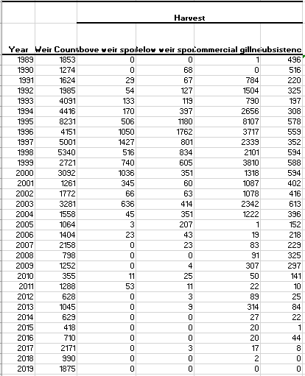
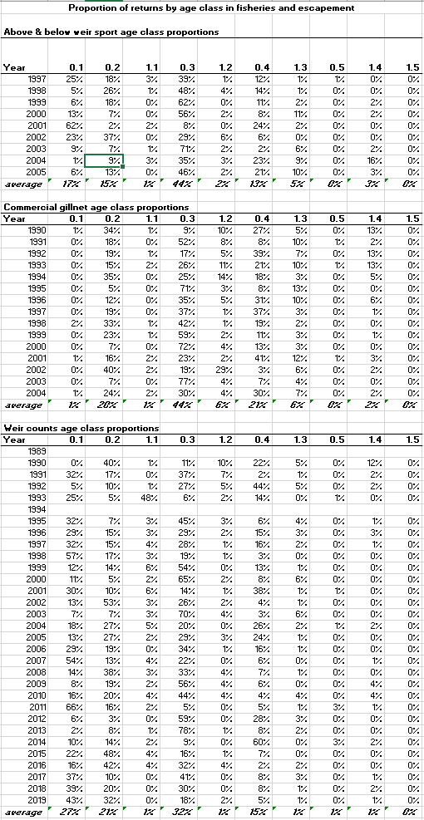
Situk River Chinook
1989-2019
Data: Annual escapement counts at a weir
Annual harvest by fishery: sport (above and below weir), commercial gillnet, and subsistence
Age proportions from scale age data by escapement and fishery
Issues: Harvest above the weir
Scale age data sporadic
Strong temporal autocorrelation – time varying productivity? In addition to fitting a SLR model, also try fitting an AR1 model: https://hamachan.shinyapps.io/Spawner_Recruit/
Method: Construct brood table
Conduct SRA
More info: McPherson et al., 2004 FMS 05-04

Slide 7
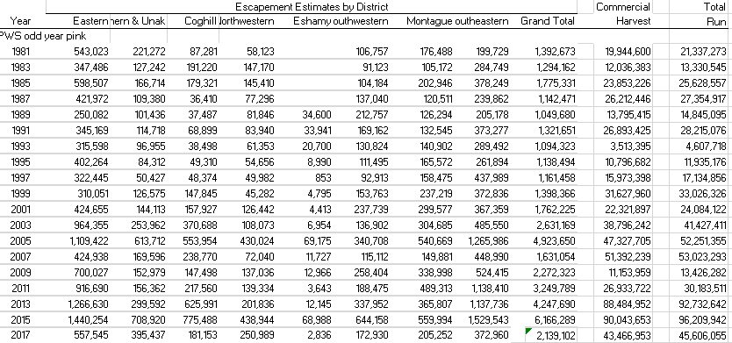
Prince William Sound Pink Salmon
1981-2015
Data: Annual AUC estimates of escapement from 134 aerial surveys across 8 districts.
Sound-wide harvests , not by district
Issues: Escapements are an index- they underestimate actual escapement
Notice that harvests can be >10-fold larger than the escapement estimates
(Naive harvest rates exceed 90%)
Method: Sound wide SRA, separately for odd and even, allowing for underestimated escapements
Assume an expansion factor, conduct SRA, convert results to escapement index currency
Assume different xfactor, repeat
If results similar, they are robust to assumptions
More info: Haught et al 2017 FMS17-10

Slide 8
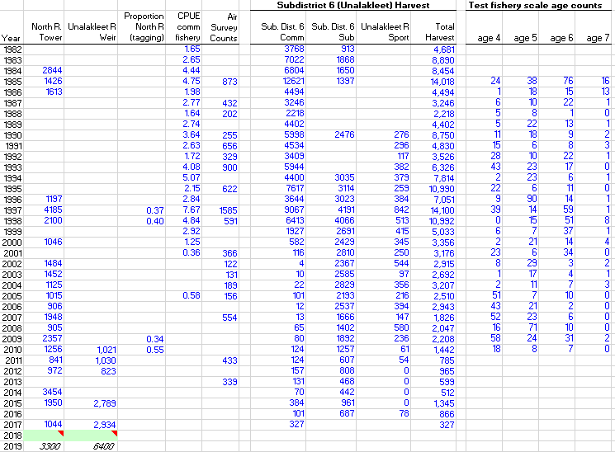
Unalakleet River Chinook
1982-2019
Data: Tower counts North River 1984+
Weir Unalakleet mainstem 2010+
Tagging North vs mainstem
CPUE comm fishery (abund index)
Aerial surveys (spotty)
Scale sample ages (testfish ‘85-’10)
Issue: Stock of concern since ???
Percentile goal okay?
Harv rate poorly understood
Method: Reconstruct historical abundance
Get approx. harvest rate
Consider SRA
More
Info: Leon 2018 SP18-17

Slide 9
